Slide 1
NAUTILUS HIGH DUMP HYDRAULIC/ELECTRICAL MANIFOLD ILLISTRATION

Slide 2
5.1 HOPPER LOWER
5.2 HOPPER LIFT
5.3 BUMPER LOWER
5.4 BUMPER LIFT
2 HOPPER DOOR
R-1, LATCH RELAY
R-3, HOPPER RELAY
R-2, BUMPER
RELAY

Slide 3
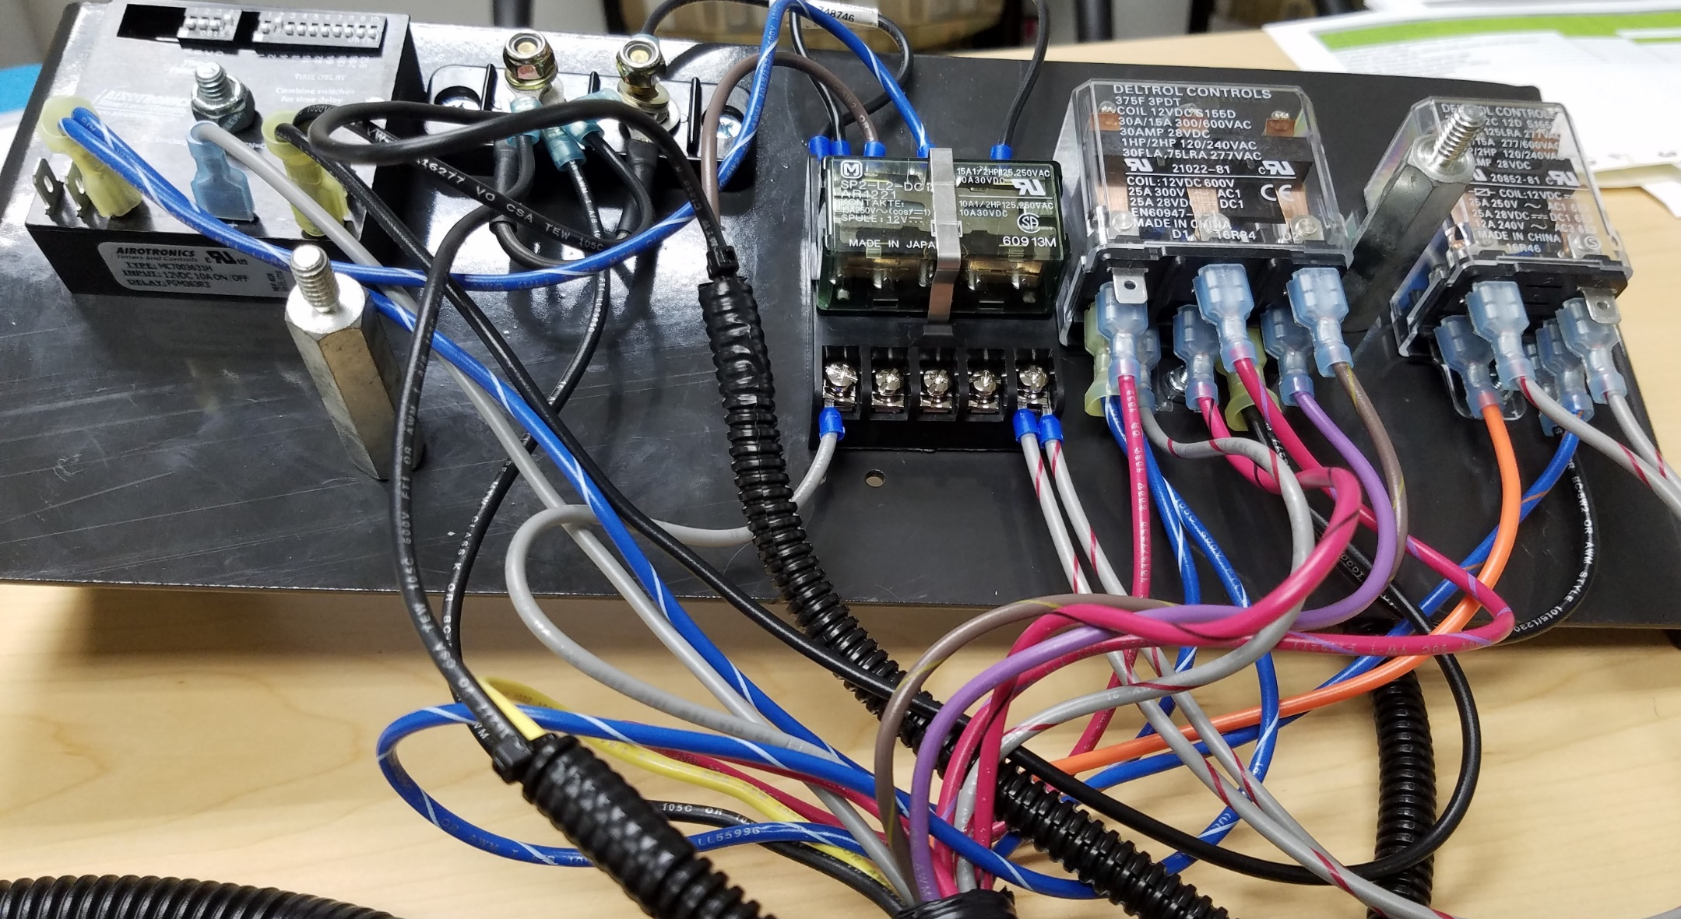

Slide 4
HOPPER TIMER (T-8)
R-1, LATCH RELAY

Slide 5
R-3, HOPPER RELAY
R-2, BUMPER RELAY

